Slide 1

Introduction to Data Science
Ahreum Amy Han, IBM

Slide 2
Let’s get started!
https://github.com/ahan02/Data-Science-Hackathon-Workshop-at-UKC-2019

Slide 3
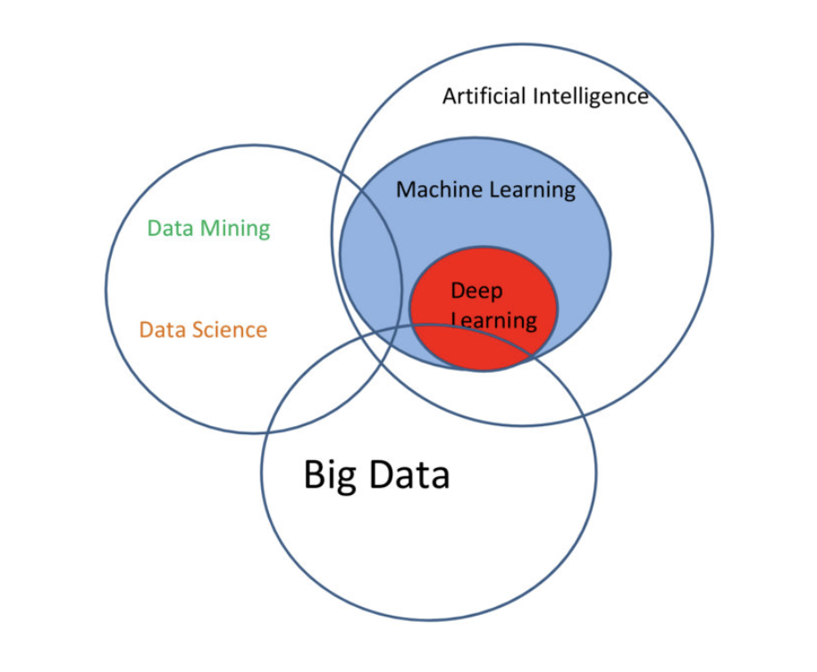
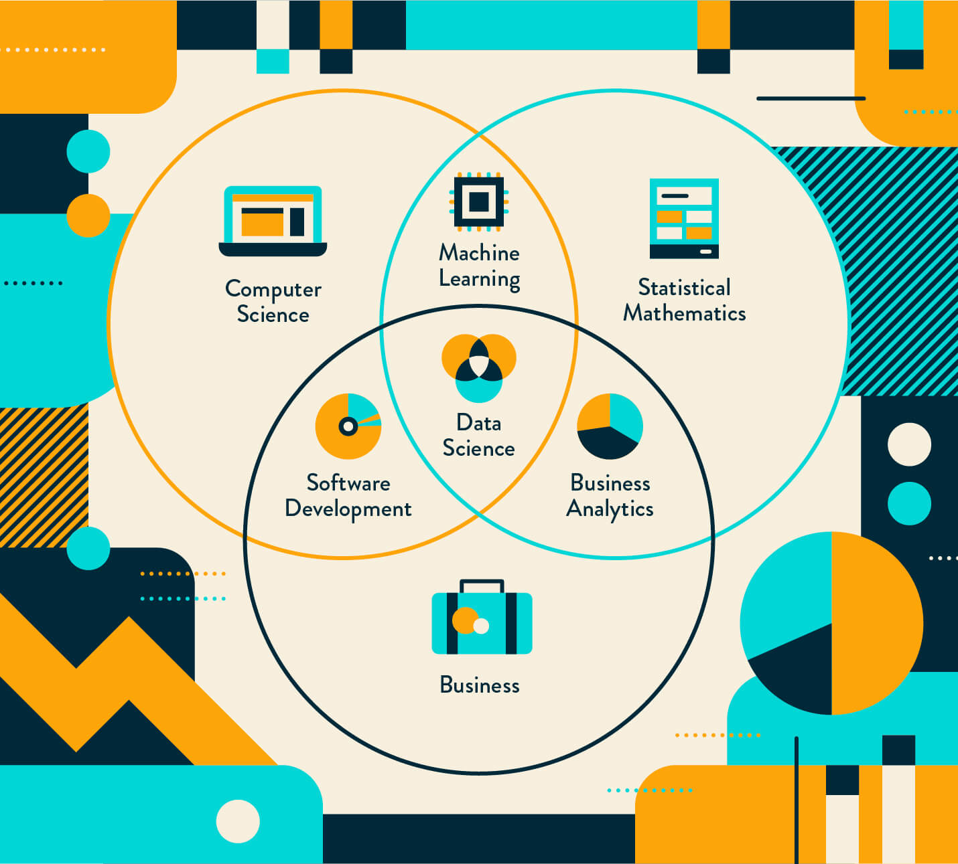
https://whatsthebigdata.com/2016/10/17/visually-linking-ai-machine-learning-deep-learning-big-data-and-data-science/
https://clevertap.com/blog/data-science/
Notes:
Deep Learning
Neural networks are inspired by our understanding of the biology of our brains – all those interconnections between the neurons.
DL is the next evolution of machine learning.
For example, while DL can automatically discover the features to be used for classification, ML requires these features to be provided manually.
Deep learning is a subset of AI and machine learning that uses multi-layered artificial neural networks to deliver state-of-the-art accuracy in tasks such as object detection, speech recognition, language translation and others.
Deep learning differs from traditional machine learning techniques in that they can automatically learn representations from data such as images, video or text, without introducing hand-coded rules or human domain knowledge. Their highly flexible architectures can learn directly from raw data and can increase their predictive accuracy when provided with more data.
artificial intelligence can be loosely interpreted to mean incorporating human intelligence to machines.
Whenever a machine completes tasks based on a set of stipulated rules that solve problems (algorithms), such an “intelligent” behavior is what is called artificial intelligence.

Slide 4
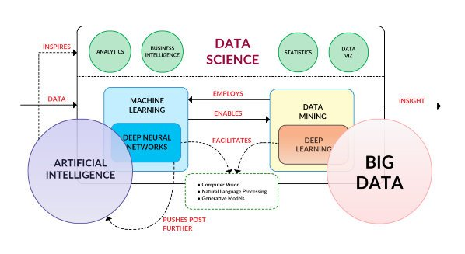
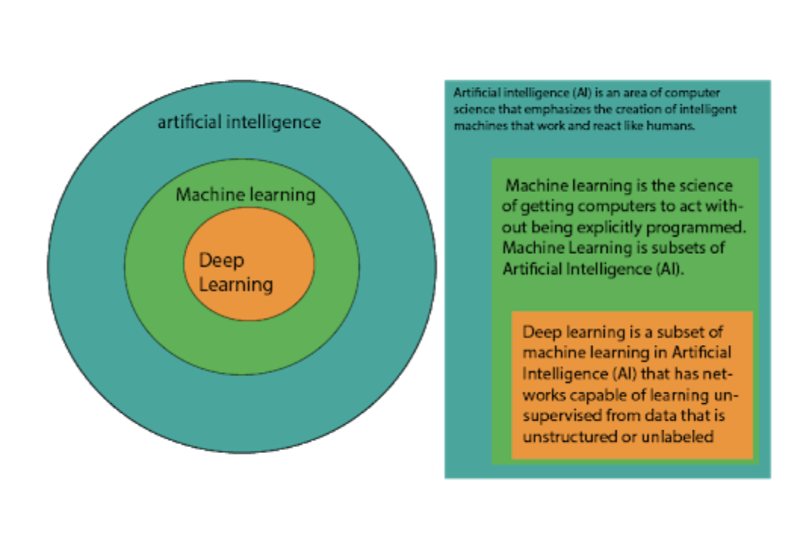
https://whatsthebigdata.com/2016/10/17/visually-linking-ai-machine-learning-deep-learning-big-data-and-data-science/
https://maxchama.blogspot.com/2019/03/artificial-intelligence-ai-vs-machine.html
Notes:
Deep Learning
Neural networks are inspired by our understanding of the biology of our brains – all those interconnections between the neurons.
DL is the next evolution of machine learning.
For example, while DL can automatically discover the features to be used for classification, ML requires these features to be provided manually.
Deep learning is a subset of AI and machine learning that uses multi-layered artificial neural networks to deliver state-of-the-art accuracy in tasks such as object detection, speech recognition, language translation and others.
Deep learning differs from traditional machine learning techniques in that they can automatically learn representations from data such as images, video or text, without introducing hand-coded rules or human domain knowledge. Their highly flexible architectures can learn directly from raw data and can increase their predictive accuracy when provided with more data.
artificial intelligence can be loosely interpreted to mean incorporating human intelligence to machines.
Whenever a machine completes tasks based on a set of stipulated rules that solve problems (algorithms), such an “intelligent” behavior is what is called artificial intelligence.

Slide 5
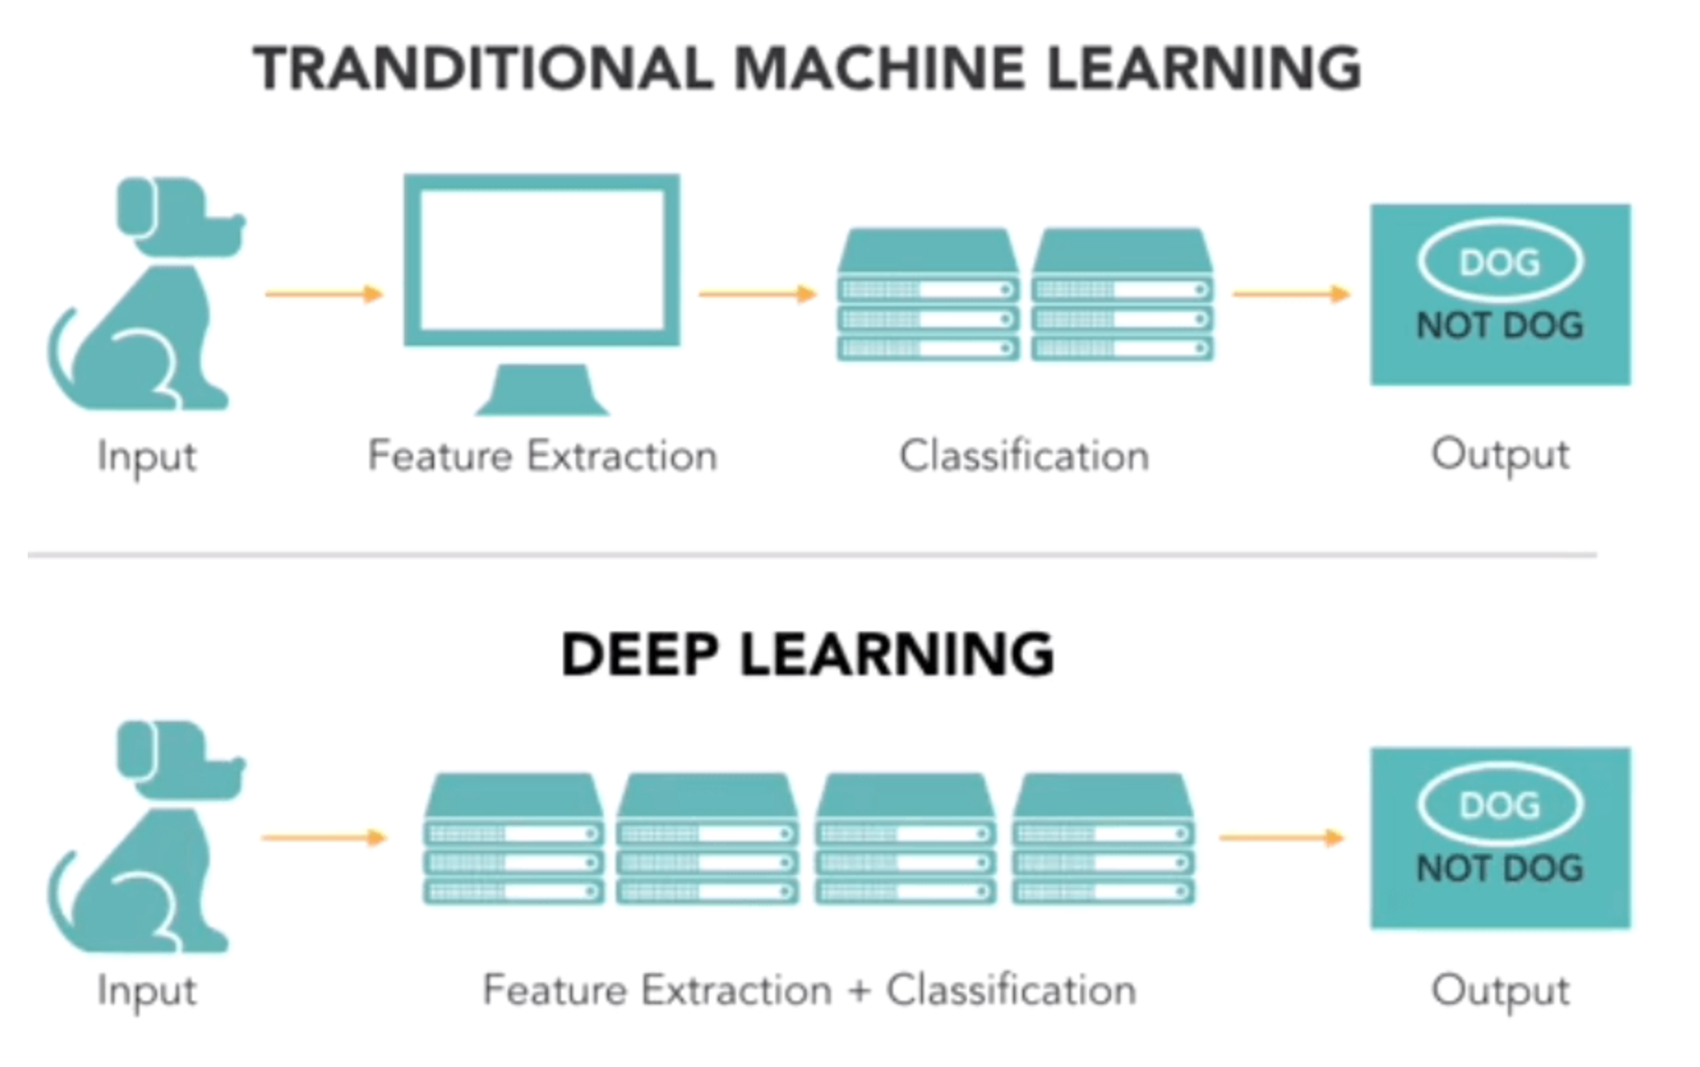
From image processing, the Data Scientist needs to extract the feature manually in the images (e.g. the eyes, the nose, lips and etc). Then features later feed to the classification model.
In Deep learning, there is no manual extraction in need. The first layer of a neural network will learn small details from the images, then from the next layers, it allows to learn more complex information from previous knowledge. Then, this network applies a filter to the images based on matching criteria by checking if the shape of the feature is identical to a part of the image. So this feature extraction is done automatically.
https://www.guru99.com/machine-learning-vs-deep-learning.html

Slide 6
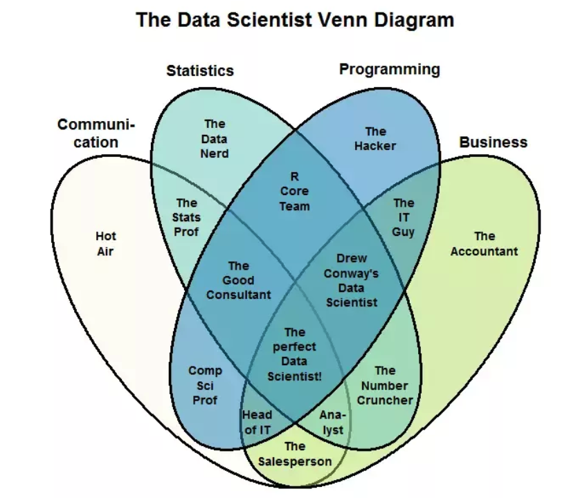
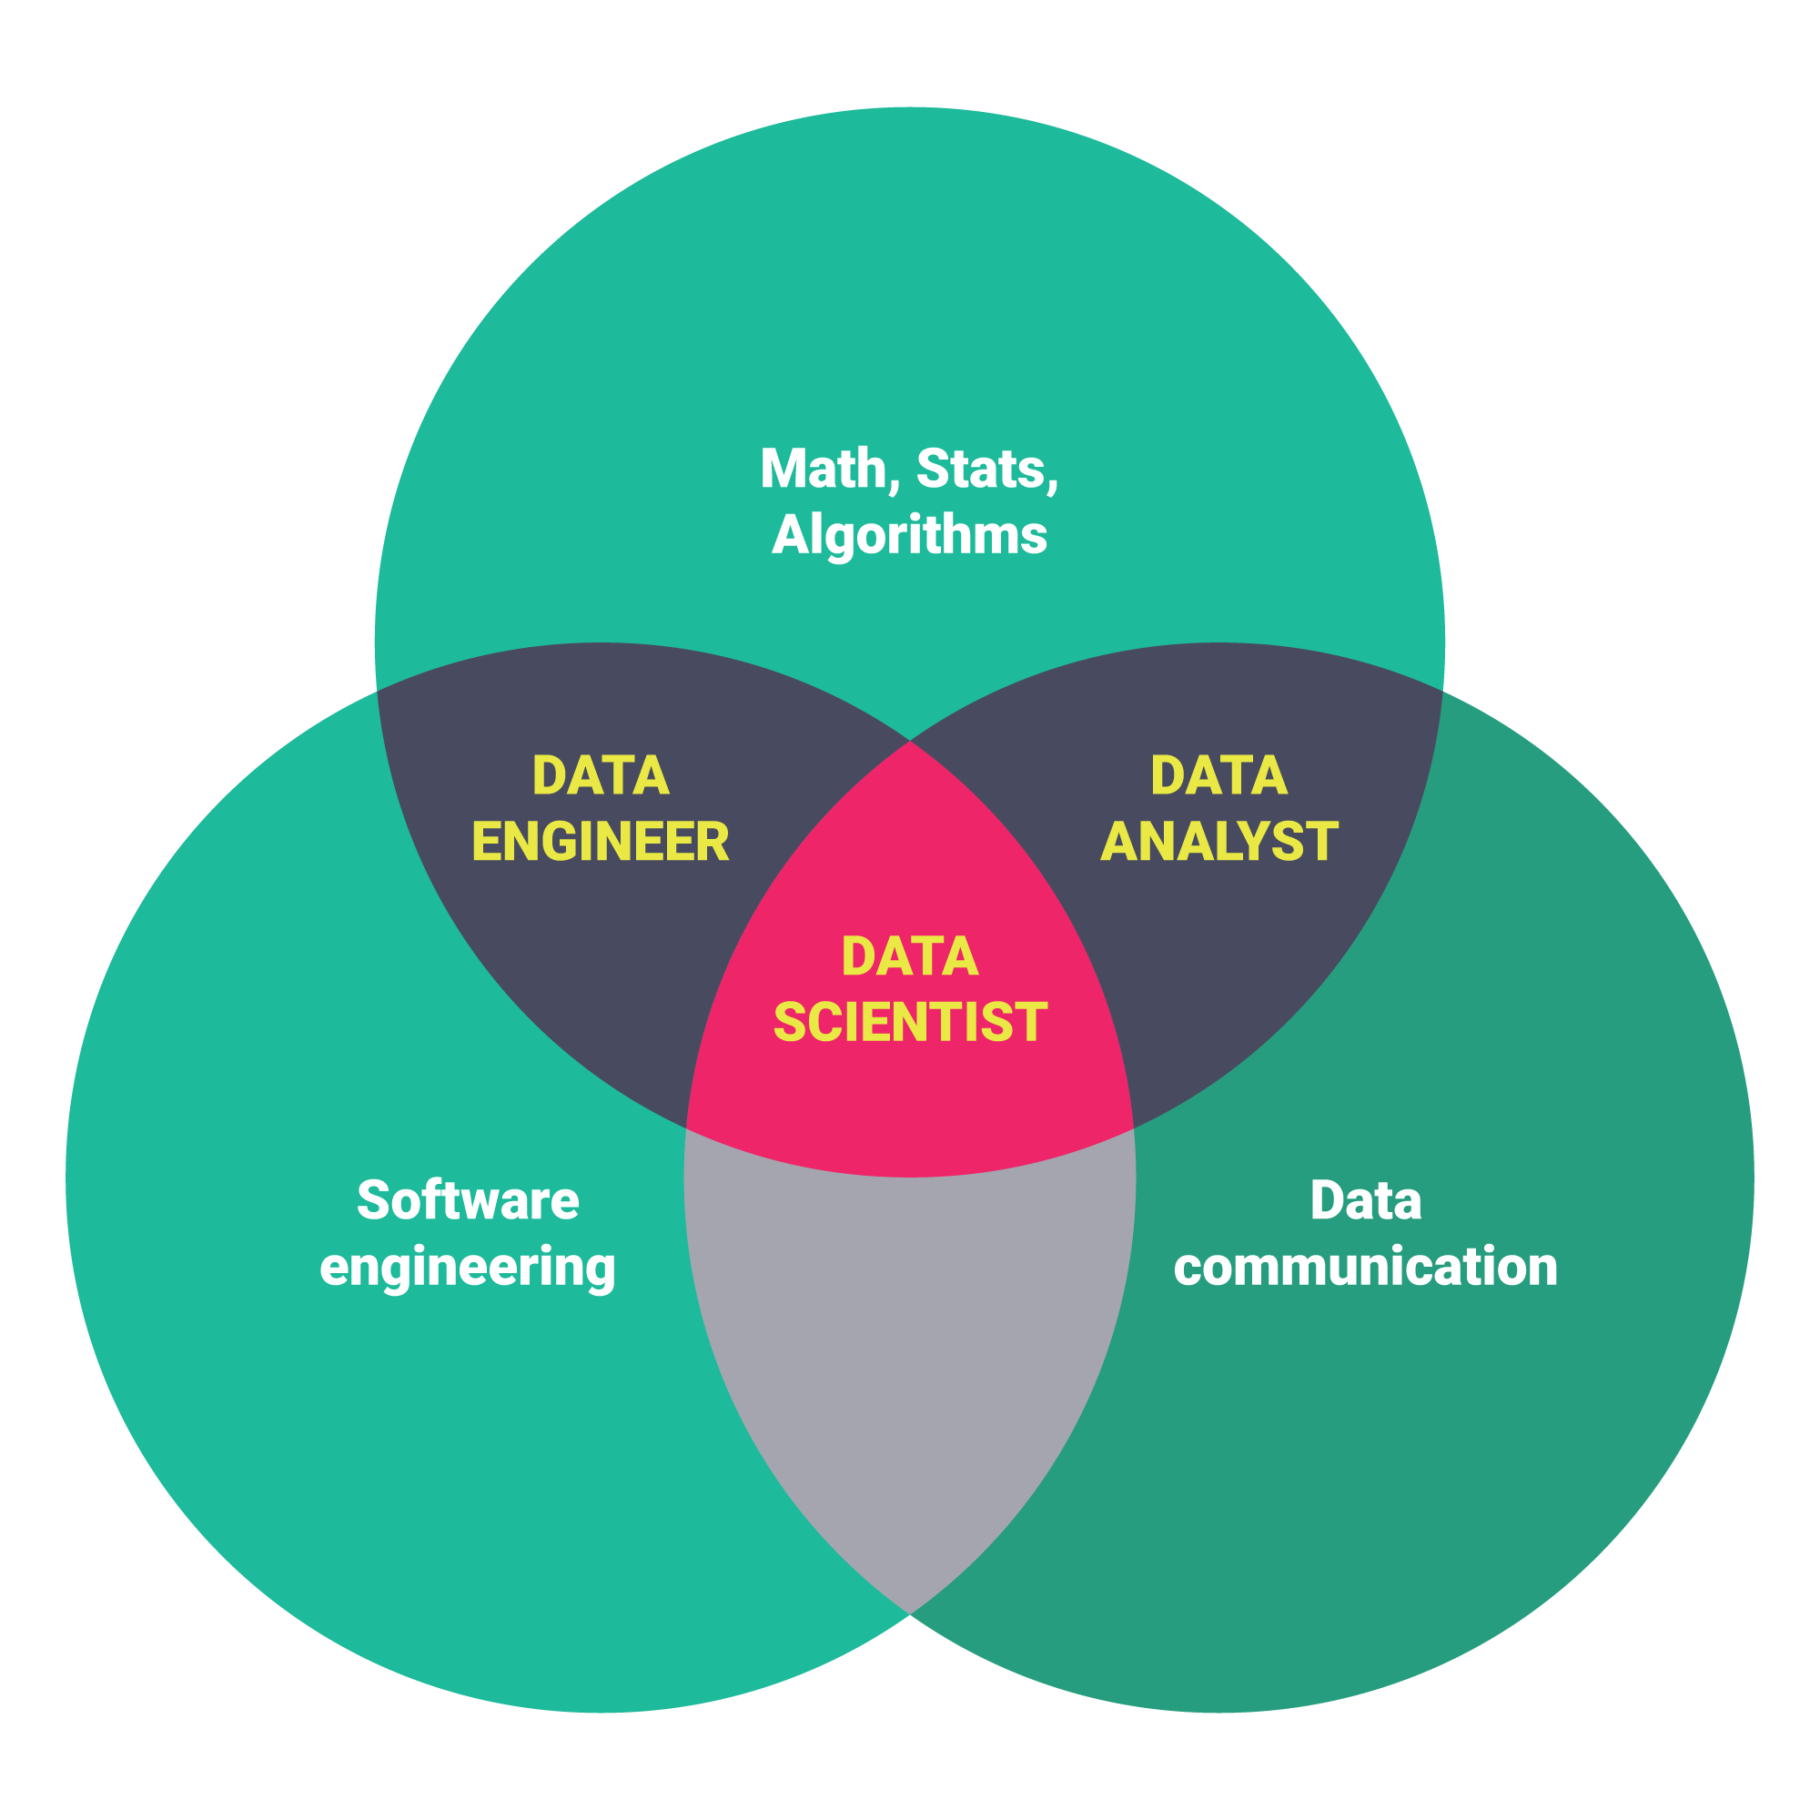
https://www.techiexpert.com/close-look-data-scientist-vs-data-engineer/
https://dzone.com/articles/data-science-vs-data-analysis-whats-the-difference

Slide 7
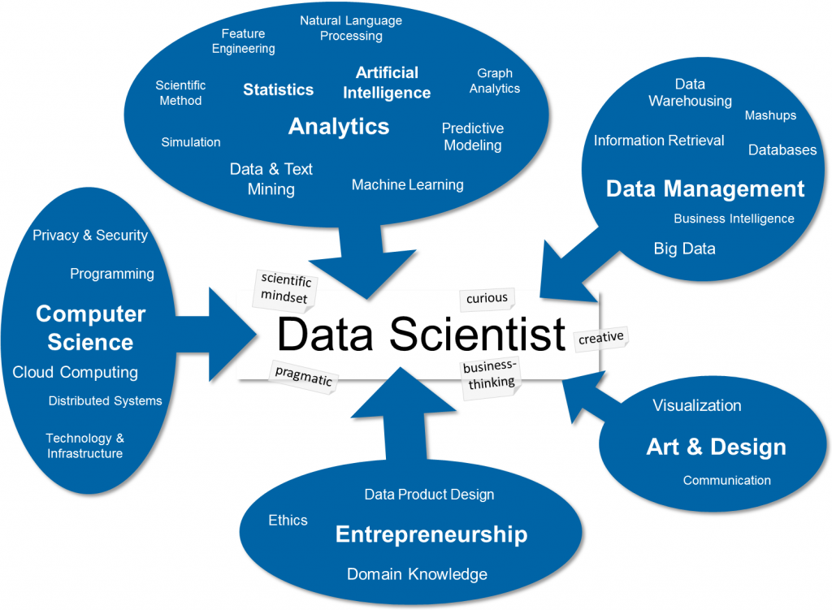
https://blog.zhaw.ch/datascience/the-data-science-skill-set/
Notes:
Data scientist tops Glassdoor's 2019 'Best Jobs in America' ranking

Slide 8
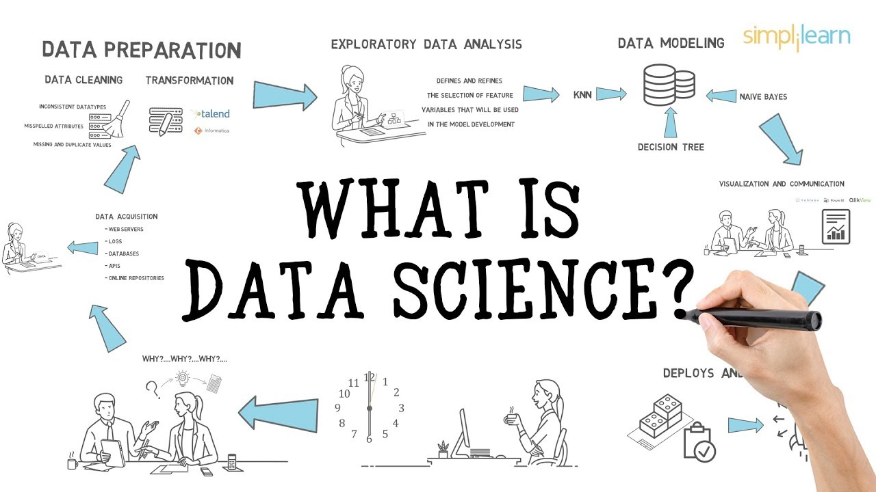
https://www.youtube.com/watch?v=X3paOmcrTjQ

Slide 9
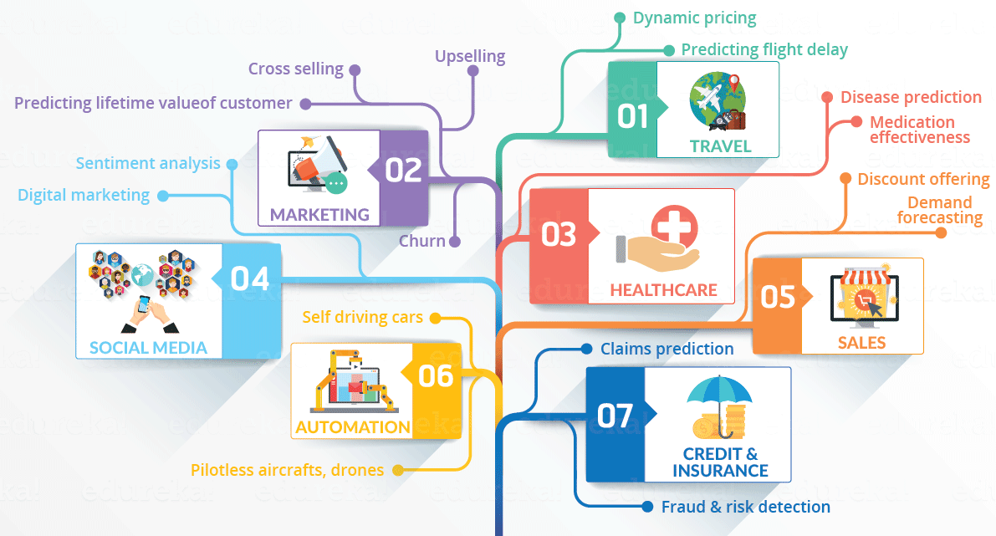
Industry Use Cases
Tech industries uses speech and image recognition feature to help you. Even if you aren’t in a position to type a message, it allows you to generally speak out the message and it will be converted to text or search images easily. Using recommender system, companies like Amazon, Twitter, Google Play, Netflix, LinkedIn can improve user experience
Airline industries use data science to come up with strategic areas of improvements. Predicting flight delays, and effectively drive customer loyalty programs, and more
Banking companies learned to divide and conquer data via customer profiling, past expenditures and other essential variables to analyze the probabilities of risk and default
Logistic companies like DHL, FedEx, UPS have used data science to improve their operational efficiency. Using data science, these companies have discovered the best routes to ship, the best suited time to deliver, the best mode of transport to choose thus leading to cost efficiency
https://www.edureka.co/blog/what-is-data-science/
https://www.analyticsvidhya.com/blog/2015/09/applications-data-science/

Slide 10
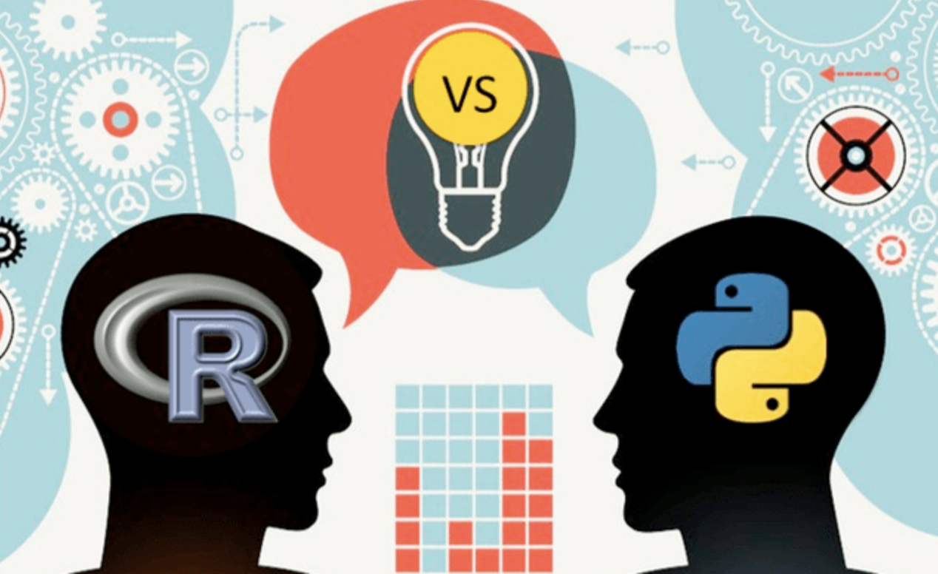
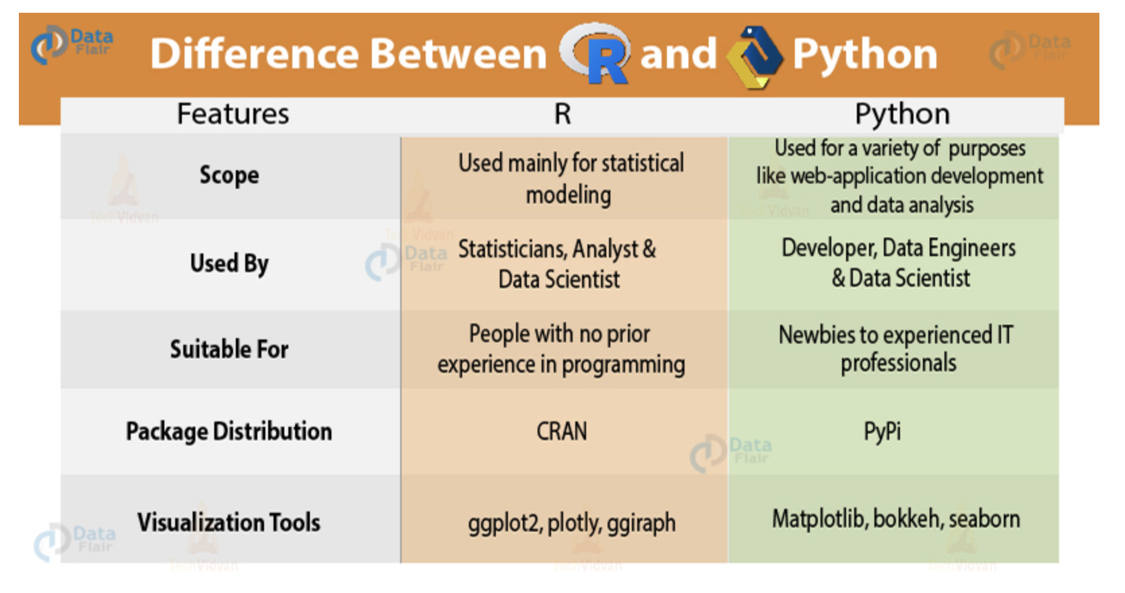
Tools
https://www.slideshare.net/OutreachDigital/r-vs-python-vs-sas
https://www.datacamp.com/community/tutorials/r-or-python-for-data-analysis
https://data-flair.training/blogs/r-vs-python-for-data-science/

Slide 11
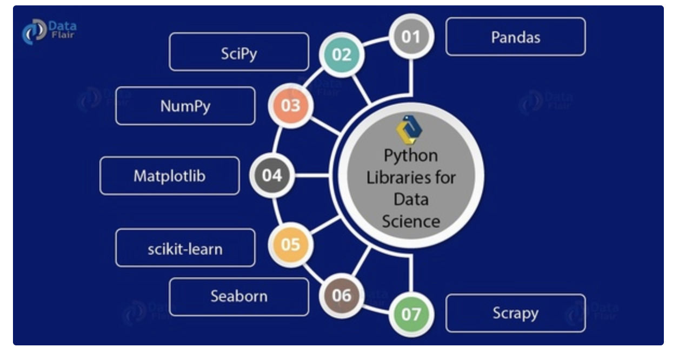
Popular Python Libraries
1. Pandas
Pandas help with munging and preparing data. It is useful to operate and maintaining structured data.
2. SciPy
SciPy (Scientific Python) allows functionality like Linear Algebra, Fourier Transform, Optimization, and many others.
3. NumPy
NumPy (Numerical Python) lets us deal with features like linear algebra, Fourier transforms and advanced random number capabilities. One very import feature of NumPy is the n-dimensional array.
4. Matplotlib
It’s useful for plotting different kinds of graphs. These include pie charts, bar graphs, histograms, and even heat plots.
5. Scikit-learn
Scikit-learn is great for machine learning. For statistically modeling and implement machine learning. The tools for these include clustering, regression, classification, and dimensionality reduction.
6. Seaborn
Useful for statistical data visualization.
7. Scrapy
Helps to crawl the web.
https://www.quora.com/Which-Python-libraries-are-commonly-used-in-the-data-analysis-data-science-world

Slide 12
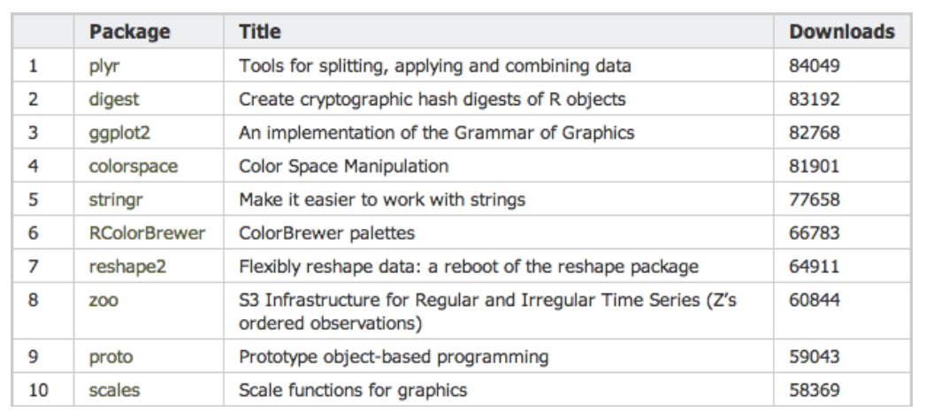
Popular R Packages
https://blog.revolutionanalytics.com/2013/06/a-list-of-r-packages-by-popularity.html
Additional ones:
dplyr, a grammar of data manipulation
devtools, a collection of package development tools
cluster, methods for cluster analysis
tm, framework for text mining application
https://blog.revolutionanalytics.com/2016/11/most-popular-r-packages.html

Slide 13
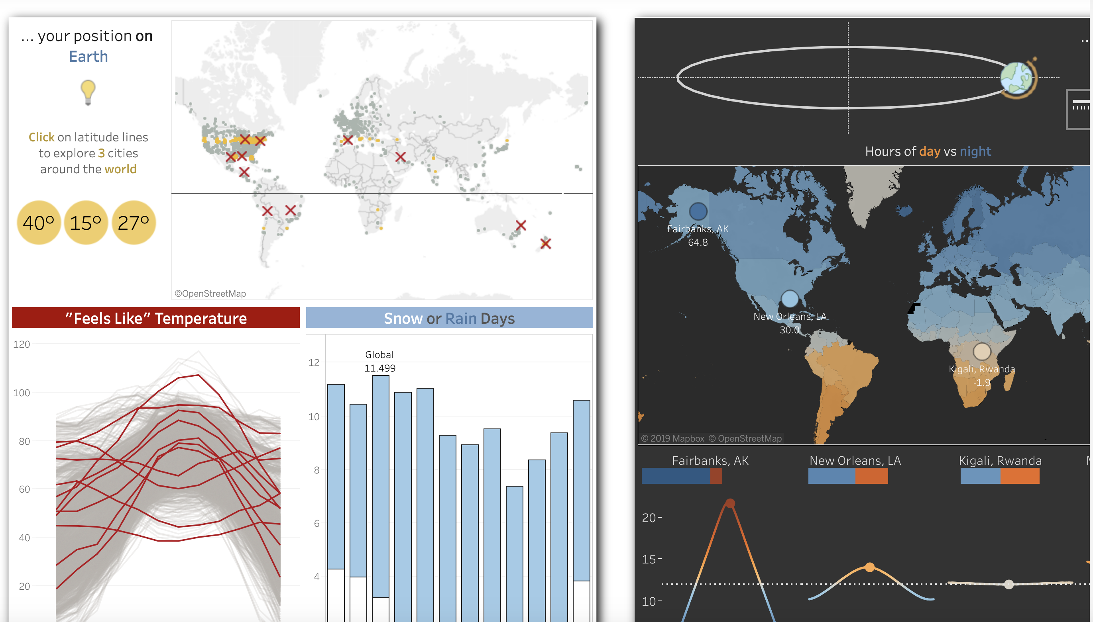
Data Visualization: Tableau vs. Power BI
https://public.tableau.com/en-us/s/
https://public.tableau.com/en-us/s/gallery/weather-location-relative?gallery=votd
https://powerbi.microsoft.com/en-us/

Slide 14
References
https://medium.com/@purnasaigudikandula/best-resources-for-deep-learners-machine-learning-artificial-intelligence-programming-be11c568b2fe

